Slide 1
JavaScript
Web Programming

Slide 2
Topics
Objects
Arrays
DOM/BOM
Javascript Events

Slide 3
Objects
Objects are used to store keyed collections of various data and complex entities
An object can be created with curly brackets {…} with an optional list of properties
A property is a “key: value” pair, where key is a string (also called a “property name”), and value can be anything

Slide 4
Objects
An empty object can be created using one of two syntaxes:
let user = new Object(); // "object constructor" syntax
let user = {}; // "object literal" syntax

Slide 5
Literals and Properties
We can put some properties into {...} as “key: value” pairs:
A property has a key (also known as “name” or “identifier”) before the colon ":" and a value to the right of it
let user = {
name: "Aster",
age: 22,
};

Slide 6
Properties
We can add, remove and read properties
Property values are accessible using the dot notation
// get property values of the object
alert( user.name ); // Aster
alert( user.age ); // 22
// add new property
user.isAdmin = true;

Slide 7
Properties
To remove a property, we can use delete operator
delete user.age;

Slide 8
Properties
We can also use multiword property names, but then they must be quoted
let user = {
name: "Aster",
age: 22,
"likes coffee": true,
};

Slide 9
Square Brackets
For multiword properties, the dot access doesn’t work
The dot requires the key to be a valid variable identifier
contains no spaces, doesn’t start with a digit and doesn’t include special characters ($ and _ are allowed)
// this would give a syntax error
User.likes coffee = true

Slide 10
Square Brackets
Square Bracket notation works with multi-word properties
let user = {};
// set
user["likes coffee"] = true;
// get
alert(user["likes coffee"]); // true
// delete
delete user["likes coffee"];

Slide 11
Square Brackets
Square brackets also provide a way to obtain the property name as the result of any expression
let user = {
name: "Aster",
age: 22,
};
let key = prompt("What do you want to know about the user?");
// access by variable
alert(user[key]); // Aster (if enter "name")

Slide 12
Computed Properties
We can use square brackets in an object literal, when creating an object
That’s called computed properties
let fruit = prompt("Which fruit to buy?", "apple");
let bag = {};
// take property name from the fruit variable
bag[fruit] = 5;

Slide 13
Property Value Shorthand
function makeUser(name, age) {
return {
name: name,
age: age,
// ...other properties
};
}
let user = makeUser("Aster", 22);
alert(user.name); // Aster
This function can be re-written as shown in the next two slides

Slide 14
Property Value Shorthand
function makeUser(name, age) {
return {
name: name,
age,
// ...other properties
};
}
let user = makeUser("Aster", 22);
alert(user.name); // Aster

Slide 15
Property Value Shorthand
function makeUser(name, age) {
return {
name,
age,
// ...other properties
};
}
let user = makeUser("Aster", 22);
alert(user.name); // Aster

Slide 16
Property Existence Test, “in” Operator
Reading a non-existing property just returns undefined
We can test whether the property exists using in operator
let user = { name: "Aster", age: 22 };
alert( "age" in user ); // true, user.age exists
alert( "blabla" in user ); // false, user.blabla doesn't exist

Slide 17
The “for…in” loop
To walk over all keys of an object, there exists a special form of the loop: for..in
let user = { name: "Aster", age: 22, isAdmin: true, };
for (let key in user) {
// keys
alert(key); // name, age, isAdmin
// values for the keys
alert(user[key]); // John, 30, true
}

Slide 18
Exercise
Write the code, one line for each action:
Create an empty object user
Add the property name with the value Abebe
Add the property surname with the value Kebede
Change the value of the name to Aster
Remove the property name from the object

Slide 19
Exercise
Write the function isEmpty(obj) which returns true if the object has no properties, false otherwise.
It should work as follows
let schedule = {};
alert( isEmpty(schedule) ); // true
schedule["8:30"] = "get up";
alert( isEmpty(schedule) ); // false

Slide 20
Exercise
Write the code to sum all salaries in the following object and store in the variable sum
If salaries is empty, then the result must be 0 otherwise it should be 390
let salaries = {
Kebede: 100,
Aster: 160,
Kedir: 130,
};

Slide 21
Exercise
Create a function multiplyNumeric(obj) that multiplies all numeric property values of obj by 2
multiplyNumeric(menu);
// after the call
menu = {
width: 400,
height: 600,
title: "My menu",
};
// before the call
let menu = {
width: 200,
height: 300,
title: "My menu",
};

Slide 22
Object References and Copying
One of the fundamental differences of objects versus primitives is that
objects are stored and copied “by reference”, whereas
primitive values: strings, numbers, booleans, etc – are always copied “by value”

Slide 23
Object References and Copying
Copying for primitive data type
Changing the value of phrase affect the value of message?
What is the output of the following
let message = "Hello!";
let phrase = message;
phrase = "Hello World!"
alert(message);
alert(phrase);

Slide 24
Object References and Copying
A variable assigned to an object stores not the object itself, but its “address in memory” – in other words “a reference” to it
What will be the output of alert in the last line
let user = { name: 'Aster' };
let admin = user;
admin.name = 'Marta';
alert(user.name);

Slide 25
Comparison by Reference
Two objects are equal only if they are the same object.
let a = {};
let b = a; // copy the reference
alert( a == b ); // true,
alert( a === b ); // true

Slide 26
Comparison by Reference
Two independent objects are not equal
let a = {};
let b = {}; // two independent objects
alert( a == b ); // false

Slide 27
Arrays
There are two syntaxes for creating an empty array:
let arr = new Array();
let arr = [];

Slide 28
Arrays
Array elements are numbered, starting with zero
let fruits = ["Apple", "Orange", "Plum"];
alert( fruits[0] ); // Apple
alert( fruits[1] ); // Orange
alert( fruits[2] ); // Plum

Slide 29
Arrays
We can replace an element
fruits[2] = 'Pear'; // now ["Apple", "Orange", "Pear"]

Slide 30
Arrays
We can add a new one to the array
fruits[3] = 'Lemon'; // now ["Apple", "Orange", "Pear", "Lemon"]

Slide 31
Arrays
The total count of the elements in the array is its length:
let fruits = ["Apple", "Orange", "Plum"];
alert( fruits.length ); // 3

Slide 32
Arrays
An array can store elements of any type
// mix of values
let arr = [ 'Apple', { name: 'Aster' }, true, function() { alert('hello'); } ];
// get the object at index 1 and then show its name
alert( arr[1].name ); // Aster
// get the function at index 3 and run it
arr[3](); // hello

Slide 33
Methods pop/push, shift/unshift
A queue is one of the most common uses of an array which supports two operations:
push appends an element to the end
shift get an element from the beginning

Slide 34
Methods pop/push, shift/unshift
There’s another use case for arrays – the data structure named stack
It supports two operations
push add an element to the end
pop takes an element from the end

Slide 35
Methods pop/push, shift/unshift
pop
let fruits = ["Apple", "Orange", "Pear"];
alert( fruits.pop() ); // remove "Pear" and alert it
alert( fruits ); // Apple, Orange

Slide 36
Methods pop/push, shift/unshift
push
let fruits = ["Apple", "Orange"];
fruits.push("Pear");
alert( fruits ); // Apple, Orange, Pear

Slide 37
Methods pop/push, shift/unshift
shift
let fruits = ["Apple", "Orange", "Pear"];
alert( fruits.shift() ); // remove Apple and alert it
alert( fruits ); // Orange, Pear

Slide 38
Methods pop/push, shift/unshift
unshift
let fruits = ["Orange", "Pear"];
fruits.unshift('Apple');
alert( fruits ); // Apple, Orange, Pear

Slide 39
Methods pop/push, shift/unshift
Methods push and unshift can add multiple elements at once
let fruits = ["Apple"];
fruits.push("Orange", "Peach");
fruits.unshift("Pineapple", "Lemon");
// ["Pineapple", "Lemon", "Apple", "Orange", "Peach"]
alert( fruits );

Slide 40
Array
An array is a special kind of object thus behaves like an object
let fruits = ["Banana"]
let arr = fruits; // copy by reference
alert( arr === fruits ); // true
arr.push("Pear"); // modify the array by reference
alert( fruits ); // Banana, Pear - 2 items now

Slide 41
Iterating Over Array Elements
One approach
let arr = ["Apple", "Orange", "Pear"];
for (let i = 0; i < arr.length; i++) {
alert( arr[i] );
}

Slide 42
Iterating Over Array Elements
Using for..of
The for..of doesn’t give access to the index of the current element, just its value
let arr = ["Apple", "Orange", "Pear"];
// iterates over array elements
for (let fruit of fruits) {
alert(fruit);
}

Slide 43
Iterating Over Array Elements
Because arrays are objects, it is also possible to use for..in but not recommended as it is 10 to 100 times slower
let arr = ["Apple", "Orange", "Pear"];
for (let key in arr) {
alert( arr[key] ); // Apple, Orange, Pear
}

Slide 44
A word about “length”
The length property automatically updates when we modify the array
It is actually not the count of values in the array, but the greatest numeric index plus one
let fruits = [];
fruits[123] = "Apple";
alert( fruits.length ); // 124

Slide 45
A word about “length”
The length property is also writable
If we increase it manually, nothing interesting happens
But if we decrease it, the array is truncated

Slide 46
Exercise
What is this code going to show?
let fruits = ["Apples", "Pear", "Orange"];
// push a new value into the "copy"
let shoppingCart = fruits;
shoppingCart.push("Banana");
// what's in fruits?
alert( fruits.length ); // ?

Slide 47
Exercise
Create an array styles with items “Jazz” and “Blues”
Append “Rock-n-Roll” to the end
Replace the value in the middle by “Classics”
Your code for finding the middle value should work for any arrays with odd length
Strip off the first value of the array and show it
Prepend Rap and Reggae to the array

Slide 48
Exercise
Write the function sumInput() that:
Asks the user for values using prompt and stores the values in the array
Finishes asking when the user enters a non-numeric value, an empty string, or presses “Cancel”
Calculates and returns the sum of array items

Slide 49
Modules
As our application grows bigger, we want to split it into multiple files, so called “modules”
A module is just a file
One script is one module

Slide 50
Modules
Modules can load each other and use special directives export and import to interchange functionality, call functions of one module from another one:
export keyword labels variables and functions that should be accessible from outside the current module
import allows the import of functionality from other modules

Slide 51
Modules: Export/Import a function
// 📁 sayHi.js
export function sayHi(user) {
alert(`Hello, ${user}!`);
}
// 📁 main.js
import { sayHi } from "./sayHi.js";
alert(sayHi); // function...
sayHi("Aster"); // Hello, Aster!

Slide 52
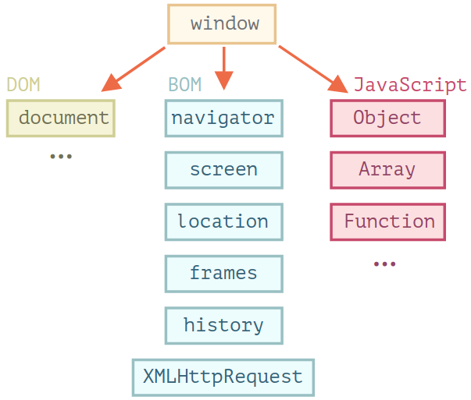
Browser Environment
There’s a global object called window

Slide 53
Browser Environment
There’s a “root” object called window
It has two roles:
it is a global object for JavaScript code
it represents the “browser window” and provides methods to control it

Slide 54
window
As a global object
function sayHi() {
alert("Hello");
}
// global functions are methods of the global object:
window.sayHi();

Slide 55
window
As a browser window, to see the window height
alert(window.innerHeight); // inner window height

Slide 56
The Global Object in Web Browsers
There is one global object per browser window or tab
All of the JavaScript code (except code running in worker threads) running in that window shares this single global object
The global object is where JavaScript’s standard library is defined
the parseInt() function, the Math object, the Set class, and so on

Slide 57
The Global Object in Web Browsers
In web browsers, the global object also contains the main entry points of various web APIs

Slide 58
The Global Object in Web Browsers
In web browsers, the global object does double duty:
defines built-in types and functions
represents the current web browser window and defines properties like
history, which represent the window’s browsing history,and
innerWidth, which holds the window’s width in pixels

Slide 59
The Global Object in Web Browsers
One of the properties of the global object is named window, and its value is the global object itself
This means that you can simply type window to refer to the global object in your client-side code

Slide 60
window
As a global object
function sayHi() {
alert("Hello");
}
// global functions are methods of the global object
window.sayHi();

Slide 61
window
As a browser window
alert(window.innerHeight); // inner window height

Slide 62
Browser Object Model (BOM)
Represents additional objects provided by the browser (host environment)
For Example:
The navigator object provides background information about the browser and the operating system such as navigator.userAgent and navigator.platform
The location object allows us to read the current URL and can redirect the browser to a new one

Slide 63
Browser Object Model (BOM)
Represents additional objects provided by the browser (host environment)
alert(location.href); // shows current URL
if (confirm("Go to Wikipedia?")) {
location.href = "https://wikipedia.org";
}

Slide 64
Document Object Model (DOM)
Document Object represents the HTML document that is displayed in a browser window or tab
The API for working with HTML documents is known as the Document Object Model, or DOM

Slide 65
Document Object Model (DOM)
<html>
<head>
<title>Sample Document</title>
</head>
<body>
<h1>An HTML Document</h1>
<p>This is a <i>simple</i> document.</p>
</body>
</html>

Slide 66
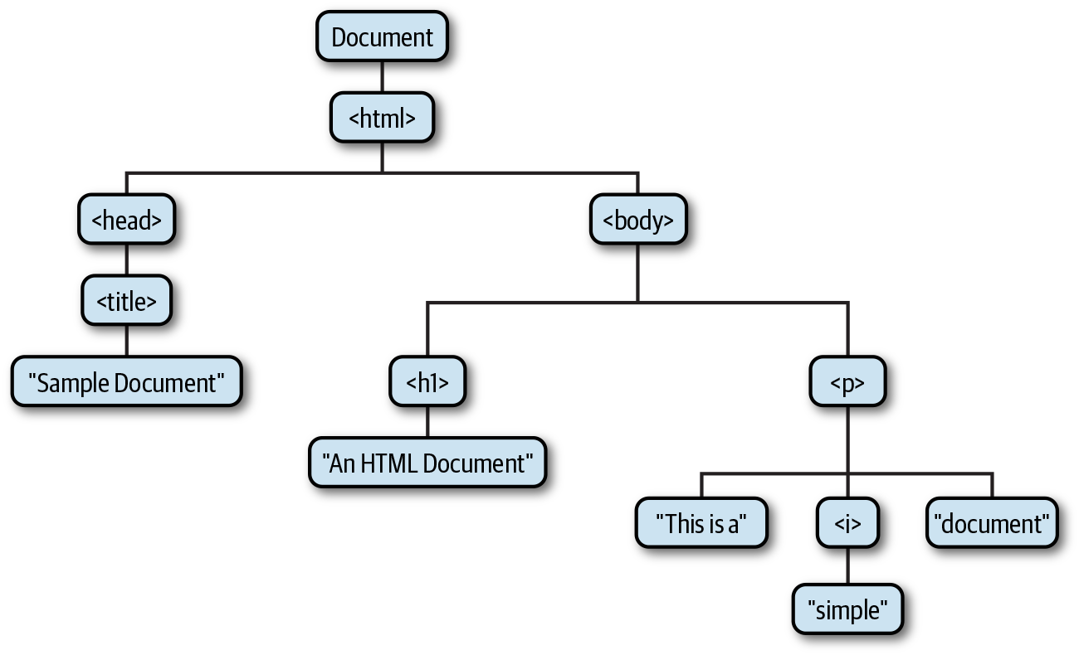
Document Object Model (DOM)

Slide 67
Document Object Model (DOM)
The DOM API mirrors the tree structure of an HTML document
for each HTML tag in the document, there is a corresponding JavaScript Element object, and
for each run of text in the document, there is a corresponding Text object
there are also methods for moving elements within the document and for removing them

Slide 68
Document Object Model (DOM)
There is a JavaScript class corresponding to each HTML tag type
Each occurrence of HTML tag in a document is represented by an instance of the class
The <body> tag, for example, is represented by an instance of HTMLBodyElement
A <table> tag is represented by an instance of HTMLTableElement

Slide 69
Document Object Model (DOM)
Most of the JavaScript element classes just mirror the attributes of an HTML tag, but some define additional methods
The HTMLAudioElement and HTMLVideoElement classes, for example, define methods like play() and pause() for controlling playback of audio and video files

Slide 70
Document Object Model (DOM)
The JavaScript element objects have properties that correspond to the HTML attributes of the tags
instances of HTMLImageElement, which represent <img> tags, have a src property that corresponds to the src attribute of the tag
The initial value of the src property is the attribute value that appears in the HTML tag, and setting this property with JavaScript changes the value of the HTML attribute (and causes the browser to load and display a new image)

Slide 71
Document Object Model (DOM)
The document object is the main “entry point” to the page
We can change or create anything on the page using it
// change the background color to red
document.body.style.background = "red";
// change it back after 1 second
setTimeout(() => document.body.style.background = "", 1000);

Slide 72
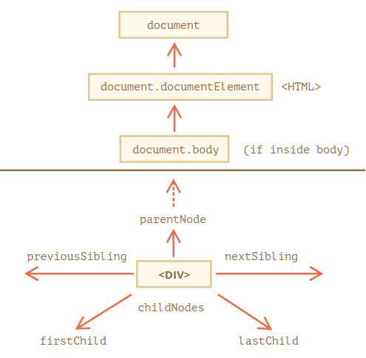
Walking the DOM
On top
<html> = document.documentElement

Slide 73
Walking the DOM
All operations on the DOM start with the document object
That’s the main “entry point” to DOM
From it we can access any node

Slide 74
Walking the DOM
TOP: documentElement, body, head
<html> = document.documentElement
<body> = document.body
<head> = document.head

Slide 75
Walking the DOM
Children: childNodes, firstChild, lastChild
Child nodes (or children) – elements that are direct children
Descendants – all elements that are nested in the given one, including children, their children and so on

Slide 76
<html>
<body>
<div>Begin</div>
<ul>
<li>Information</li>
</ul>
<div>End</div>
...more stuff...
<script src="example.js"></script>
</body>
</html>
example.js
let children = document.body.childNodes;
for (let i = 0; i < children.length; i++) {
alert(children[i]);
}

Slide 77
Walking the DOM
Children: childNodes, firstChild, lastChild
Properties firstChild and lastChild give direct access to the first and last children
There’s also a special function elem.hasChildNodes() to check whether there are any child nodes
elem.childNodes[0] === elem.firstChild
elem.childNodes[elem.childNodes.length - 1] === elem.lastChild

Slide 78
Walking the DOM
Siblings and the Parent
Siblings are nodes that are children of the same parent
// parent of <body> is <html>
alert( document.body.parentNode === document.documentElement ); // true
// after <head> goes <body>
alert( document.head.nextSibling ); // HTMLBodyElement
// before <body> goes <head>
alert( document.body.previousSibling ); // HTMLHeadElement

Slide 79
Walking the DOM
Element-Only Navigation
Navigation properties listed above refer to all nodes
For instance, in childNodes we can see both text nodes, element nodes, and even comment nodes if they exist
If you want to manipulate element nodes that represent tags and form the structure of the page, you can use element-only navigation

Slide 80
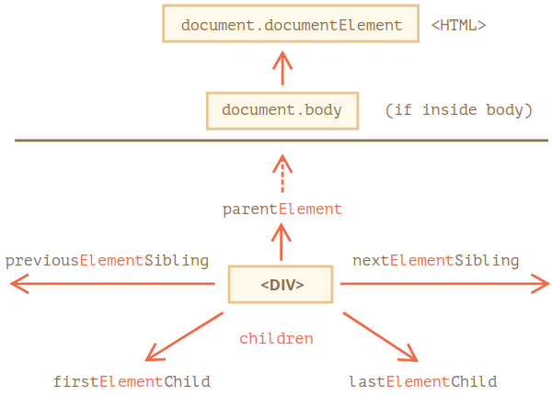
Walking the DOM
Element-Only Navigation

Slide 81
Walking the DOM
Element-Only Navigation
children – only those children that are element nodes.
firstElementChild, lastElementChild – first and last element children
previousElementSibling, nextElementSibling – neighbor elements
parentElement – parent element

Slide 82
Walking the DOM Tables
The <table> element supports the following
table.rows – the collection of <tr> elements of the table.
table.caption/tHead/tFoot – references to elements <caption>, <thead>, <tfoot>.
table.tBodies – the collection of <tbody> elements

Slide 83
Walking the DOM Tables
<thead>, <tfoot>, <tbody> elements provide the rows property:
tbody.rows – the collection of <tr> inside

Slide 84
Walking the DOM Tables
<tr>
tr.cells – the collection of <td> and <th> cells inside the given <tr>
tr.sectionRowIndex – the position (index) of the given <tr> inside the enclosing <thead>/<tbody>/<tfoot>
tr.rowIndex – the number of the <tr> in the table as a whole

Slide 85
Walking the DOM Tables
<td> and <th>
td.cellIndex – the index of the cell inside the enclosing <tr>

Slide 86
Walking the DOM Tables
<table id="table">
<tr>
<td>one</td>
<td>two</td>
</tr>
<tr>
<td>three</td>
<td>four</td>
</tr>
</table>
// get td with "two"
let td = table.rows[0].cells[1];
td.style.backgroundColor = "red";

Slide 87
Exercise
For each of the following, give at least one way of access them:
The <div> DOM node
The <ul> DOM node
The second <li> (with Pete)
<html>
<body>
<div>Users:</div>
<ul>
<li>John</li>
<li>Pete</li>
</ul>
</body>
</html>

Slide 88
Searching: getElement*, querySelector*
There are 6 main methods to search for nodes in DOM:
Method | Search By
querySelector() | CSS-selector
querySelectorAll() | CSS-selector
getElementById() | id
getElementsByName() | name
getElementsByTagName() | tag or *
getElementsByClassName() | class

Slide 89
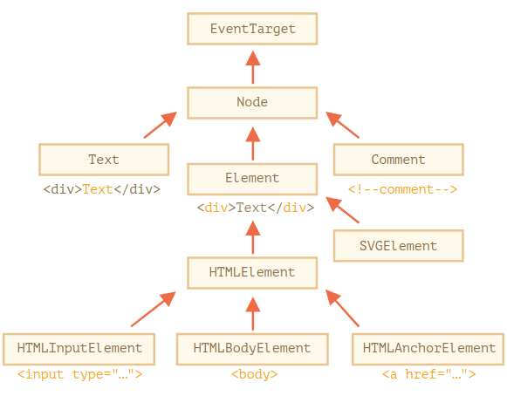
Node Properties
Each DOM node belongs to a certain class
The classes form a hierarchy

Slide 90
Main Node Properties
nodeType
We can use it to see if a node is a text or an element node
It has a numeric value:
1 for elements,
3 for text nodes, and a few others for other node types
It is read-only

Slide 91
Main Node Properties
nodeName/tagName
For elements, tag name
For non-element nodes nodeName describes what it is
It is read-only

Slide 92
Main Node Properties
innerHTML
The HTML content of the element
Can be modified

Slide 93
Main Node Properties
outerHTML
The full HTML of the element
A write operation into elem.outerHTML does not touch elem itself, instead it gets replaced with the new HTML in the outer context

Slide 94
Main Node Properties
nodeValue/data
The content of a non-element node (text, comment)
These two are almost the same, usually we use data
Can be modified

Slide 95
Main Node Properties
textContent
The text inside the element: HTML minus all <tags>
Writing into it puts the text inside the element, with all special characters and tags treated exactly as text
Can safely insert user-generated text and protect from unwanted HTML insertions

Slide 96
Main Node Properties
hidden
When set to true, does the same as CSS display:none.

Slide 97
Modifying the Document
Methods to create new nodes
document.createElement(tag) – creates an element with the given tag,
document.createTextNode(value) – creates a text node (rarely used),
elem.cloneNode(deep) – clones the element, if deep==true then with all descendants

Slide 98
Modifying the Document
Insertion and removal
node.append(...nodes or strings) – insert into node, at the end
node.prepend(...nodes or strings) – insert into node, at the beginning
node.before(...nodes or strings) –- insert right before node

Slide 99
Modifying the Document
Insertion and removal
node.after(...nodes or strings) –- insert right after node
node.replaceWith(...nodes or strings) –- replace node
node.remove() –- remove the node
Text strings are inserted “as text”

Slide 100
Modifying the Document
Insertion and removal
node.after(...nodes or strings) –- insert right after node
node.replaceWith(...nodes or strings) –- replace node
node.remove() –- remove the node
Text strings are inserted “as text”

Slide 101
Browser Events
An event is a signal that something has happened
All DOM nodes generate such signals (but events are not limited to DOM)

Slide 102
DOM Events
Mouse Events
click – when the mouse clicks on an element (touchscreen devices generate it on a tap).
contextmenu – when the mouse right-clicks on an element

Slide 103
DOM Events
Mouse Events
mouseover / mouseout – when the mouse cursor comes over / leaves an element.
mousedown / mouseup – when the mouse button is pressed / released over an element.
mousemove – when the mouse is moved

Slide 104
DOM Events
Keyboard Events
keydown and keyup – when a keyboard key is pressed and released

Slide 105
DOM Events
Form Element Events
submit – when the visitor submits a <form>
focus – when the visitor focuses on an element, e.g. on an <input>

Slide 106
DOM Events
Document Events:
DOMContentLoaded – when the HTML is loaded and processed, DOM is fully built

Slide 107
DOM Events
CSS Events
transitionend – when a CSS-animation finishes

Slide 108
Event Handlers
To react on events we can assign a handler – a function that runs in case of an event

Slide 109
Event Handlers
HTML-Attribute
A handler can be set in HTML with an attribute named on<event>.
For instance, to assign a click handler for an input, we can use onclick, like here
<input value="Click me" onclick="alert('Click!')" type="button">

Slide 110
Event Handlers
DOM Property
We can assign a handler using a DOM property on<event>
<input id="elem" type="button" value="Click me">
elem.onclick = function () {
alert("Thank you");
};
To remove a handler – assign elem.onclick = null

Slide 111
Accessing the element: this
The value of this inside a handler is the element
In the code below the button shows its contents using this.innerHTML
<button onclick="alert(this.innerHTML)">Click me</button>

Slide 112
Add Event Listener
addEventListener
The fundamental problem of the aforementioned ways to assign handlers – we can’t assign multiple handlers to one event
input.onclick = function() { alert(1); }
// ...
input.onclick = function() { alert(2); } // replaces the previous handler

Slide 113
Add Event Listener
addEventListener
The syntax to add a handler
To remove the handler, use removeEventListener
element.addEventListener(event, handler, [options]);

Slide 114
Add Event Listener
removeEventListener
to remove the handler
element.removeEventListener(event, handler, [options]);

Slide 115
Add Event Listener
<input id="elem" type="button" value="Click me"/>
function handler1() {
alert("Thanks!");
}
function handler2() {
alert("Thanks again!");
}
elem.onclick = () => alert("Hello");
elem.addEventListener("click", handler1); // Thanks!
elem.addEventListener("click", handler2); // Thanks again!

Slide 116

Web Components
How many HTML tags do you need to create the following search box?

Slide 117
Web Components
How many HTML tags do you need to create the following search box?
an <input> element to accept and display the user’s input
two <span> elements for displaying the magnifying glass and cancel Unicode Glyphs
a container <div> element to hold those three children

Slide 118
Web Components
What else do you need to do to?

Slide 119
Web Components
What else do you need to do to?
use CSS to remove the default border around the input box and to add a new border around the container div

Slide 120
Web Components
What else do you need to do to make the search box functional
use JavaScript to register event handler to handle the click events for the magnifying and cancel icons

Slide 121
Web Components
Most frontend frameworks such as React and Angular support the creation of reusable user interface components like the search box
Web Component is a browser-native alternative that allow JavaScript to extend HTML with new tags that work as self-contained, reusable UI components

Slide 122
Using Web Components
As Web components are defined in JavaScript, you need to include the JavaScript file that defines the component
<script type="module" src="components/search-box.js"></script>

Slide 123
Using Web Components
Web components define their own HTML tag names, with the important restriction that those tag names must include a hyphen
To use a web component, just use its tag in your HTML file
<search-box>
<img src="images/search-icon.png" slot="left" />
<img src="images/cancel-icon.png" slot="right" />
</search-box>

Slide 124
Browser Features of Web Components
The three web browser features that allow us to implement web components
HTML Templates
Custom Elements
Shadow DOM

Slide 125
Networking
Every time you load a web page, the browser makes network requests—using the HTTP and HTTPS protocols—for an HTML file as well as the images, fonts, scripts, and stylesheets that the file depends on
In addition to being able to make network requests in response to user actions, web browsers also expose JavaScript APIs for networking

Slide 126
Networking Javascript APIs
The fetch() method defines a Promise-based API for making HTTP and HTTPS requests
async function isServiceReady() {
let response = await fetch("/api/service/status");
let body = await response.text();
return body === "ready";
}

Slide 127
Networking Javascript APIs
The Server-Sent Events (or SSE) API is event-based interface to HTTP “long polling” techniques where the web server holds the network connection open so that it can send data to the client whenever it wants

Slide 128
Networking Javascript APIs
WebSockets allow JavaScript code in the browser to easily exchange text and binary messages with a server
As with Server-Sent Events, the client must establish the connection, but once the connection is established, the server can asynchronously send messages to the client
Unlike SSE, binary messages are supported, and messages can be sent in both directions, not just from server to client

Slide 129
References
The Modern JavaScript Tutorial
JavaScript: The Definitive Guide, 7th Edition

